Slide 1
Learning How to Study the Bible
Bible Study Methods - 2

Slide 2
Bible Study Methods - 2
Word Studies
Colossians 2:8
2 Timothy 2:14
Galatians 5:19-23

Slide 3
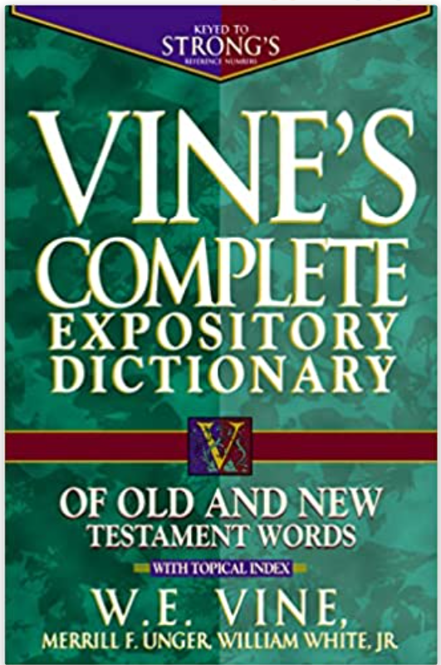
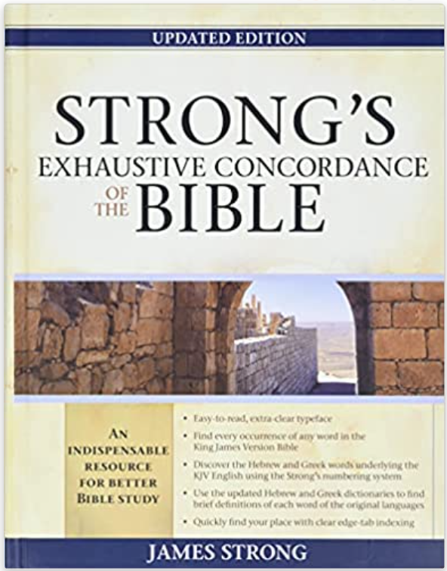
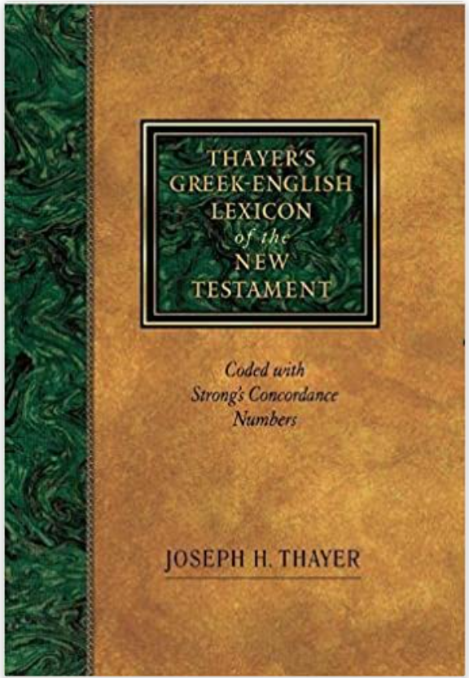
Word Studies
Three common Resources

Slide 4
Word Study – revelries (Galatians 5:21) κῶμος - kōmos
Strong – a carousal (as if letting loose):—revelling, rioting.
Vine – Revel, Revelling: "a revel, carousal," the concomitant and consequence of drunkenness, is used in the plural, Rom 13:13, translated by the singular, RV, "revelling" (AV, "rioting"); Gal 5:21; 1Pe 4:3, "revellings.“
See RIOT.

Slide 5
Word Study – revelries (Galatians 5:21) κῶμος - kōmos
Thayer – a revel, carousal, i. e. in the Greek writings properly, a nocturnal and riotous procession of half-drunken and frolicsome fellows who after supper parade through the streets with torches and music in honor of Bacchus or some other deity, and sing and play before the houses of their male and female friends; hence, used generally, of feasts and drinking-parties that are protracted till late at night and indulge in revelry

Slide 6
Bible Study Methods - 2
Textual Studies
Perhaps the most fruitful way of studying the Bible
Naturally maintains context, which helps in understanding the author’s meaning and purpose.

Slide 7
Textual Outline – 1 Corinthians 2:1-5
Title – The method of Paul in Declaring the Testimony of God
What Paul did not do:
Come with excellence of speech or of wisdom (1) (Col. 2:8)
Come with persuasive words of human wisdom (4) (Jas. 3:14-15)
What Paul did do:
Come exclusively with the knowledge of Jesus Christ and Him crucified (2) (Rom. 1:16)
Come in weakness, in fear, and in much trembling (3) (1 Cor. 3:5-7)
Demonstrated God’s power rather than his own (4) (Eph. 2:8-9)
Why did Paul do what he did?
So that their faith would not be in man’s wisdom, but God’s power (5) (Acts 17:29-31)

Slide 8
Bible Study Methods - 2
Doctrinal Studies
Ephesians 4:14-15
Jude 3
2 Timothy 4:3-4
Titus 1:9

Slide 9
Paul’s rebuttal of Paganism (Acts 17)
God is the creator of the world and life (24)
God transcends space, not limited by it (24)
God does not need man (25)
God established the nations for the purpose of revealing Himself to men (26-28)
Idolatry is a perversion, diminishing God (29)
God no longer permits such evil, and will judge man one day! (30-31)
The proof of these things is Jesus’ resurrection (31)

Slide 10
Exercise for Class
Take a text and outline it, noting the main points being made in that text. Find a corroborating verse from another place in the Bible that supports each point. Example texts you can use: 1 Corinthians 2:1-5; Ephesians 2:11-22; Hebrews 2:1-4
Or, feel free to choose a text of your own to do the exercise.

